Slide 1
Detectors
Aytan Alakbarova
Aytan Babayeva
Nijat Mursali

Slide 2
OBJECT RECOGNITION
Object Recognition is defined as computer vision technique for identifying objects in images or videos
For implementation Machine Learning approach is used such as feature extraction
Our goal is to apply this widely used application for local community purposes such spotting of violent behavior in traffic or crowded places

Slide 3

DATA PROCESSING
What is TensorFlow API?
How did we use it?
Training/Testing

Slide 4
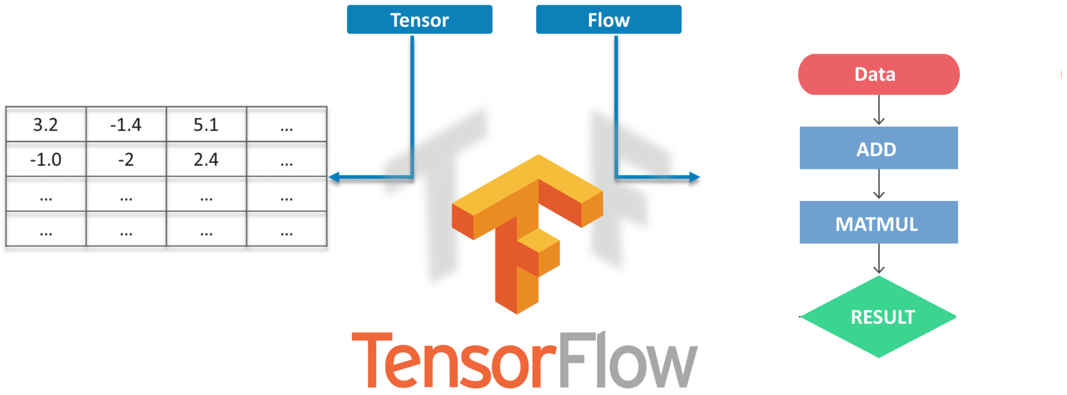
What is TensorFlow?

Slide 5
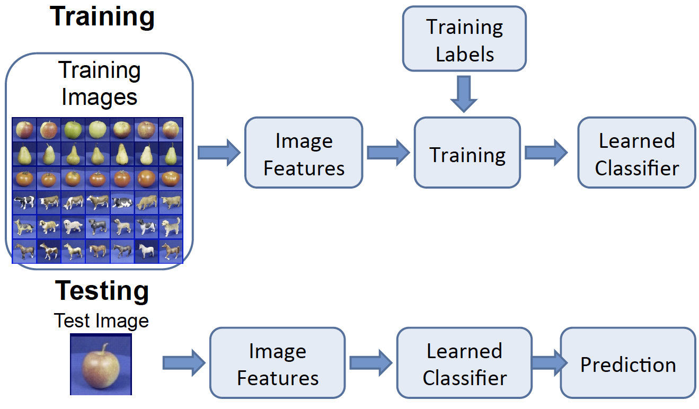
Training/Testing

Slide 6
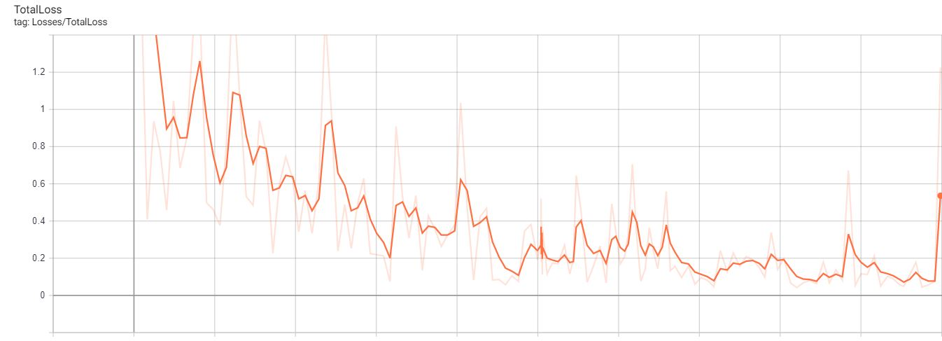
Neural Networks – Binary Classification
m – number of examples in the dataset
nx – input size
ny – output size (which is also called number of classes)
Getting 0.1 total loss at the end (initially was 4.3)
2000 steps/iterations for training the dataset
Learning rate of 0.1

Slide 7
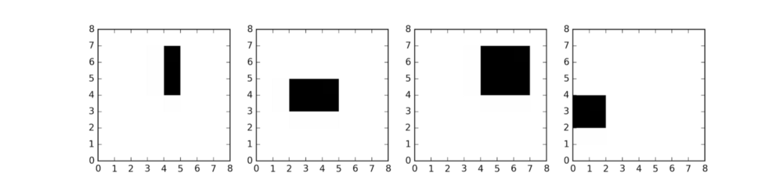
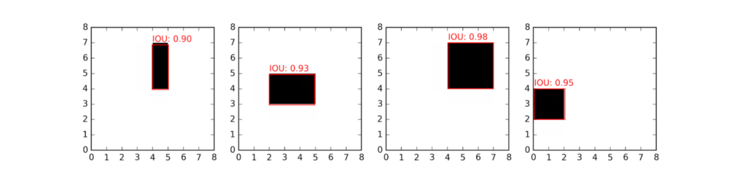
Cont. Neural Network
very simple convolutional neural network network with one hidden layer
CNNs scan the image with learnable “filters” and extract more and more abstract features at each layer
takes the flattened image (i.e. 8 x 8 = 64 values) as input
predicts the parameters of the bounding box

Slide 8
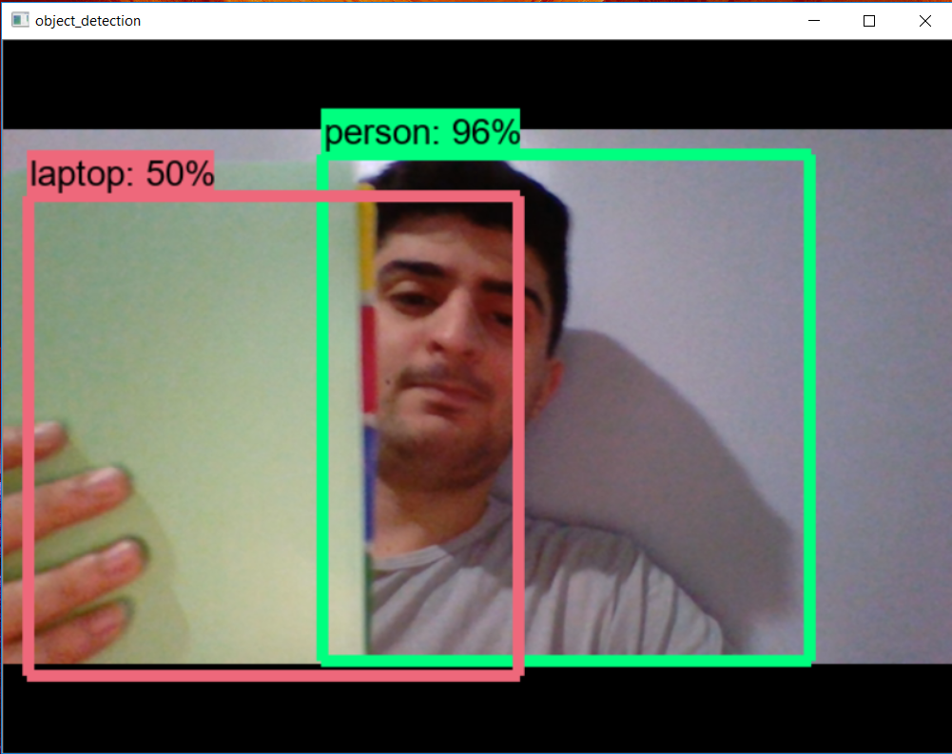
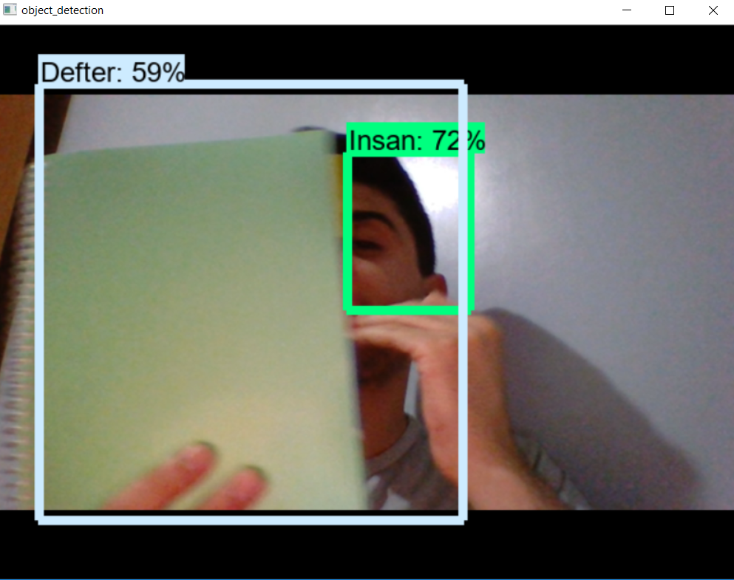
Comparison of Results

Slide 9
References
Tensorflow by Google
https://www.tensorflow.org/
A Beginner's Guide to Neural Networks and Deep Learning
https://skymind.ai/wiki/neural-network

